Slide 1

Exploratory Data Analysis-3
Complete EDA Pipeline
Today’s Agenda
Data Cleaning & Preprocessing
Feature Understanding & Relationships
Outlier Detection & Handling
Feature Engineering Techniques
Summary & Preparing for Modeling
Hands-On Practice
Kahoot(Quiz)

Slide 2
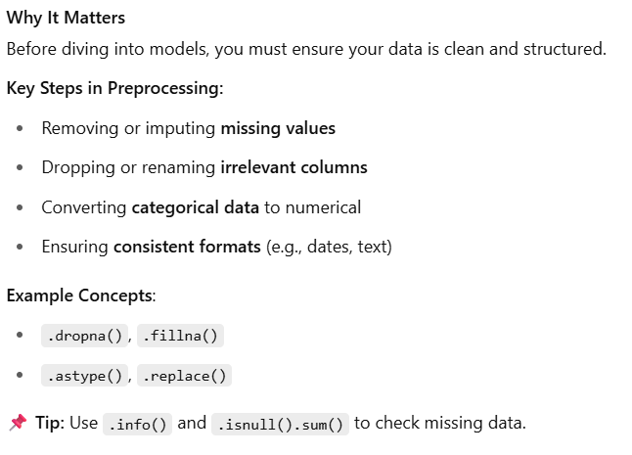
Data Cleaning & Preprocessing
Categorical data types :-
Ordinal and nomial
astype():- convert int to str
Isnull().sum() :- chain function
Sabai function ma kati ota function xa

Slide 3
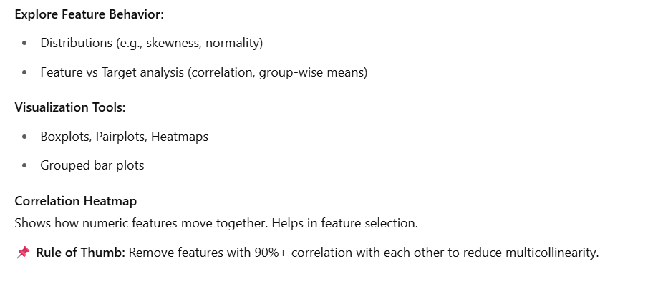
Feature Understanding & Relationships
Normality : - 0-1 ko range ma lagne
Group-wise means :- xuttai xuttai group ma division
Grouped bar plots:- quarter, eg – bank data
Multicollineraity :- reduce features of dependent

Slide 4
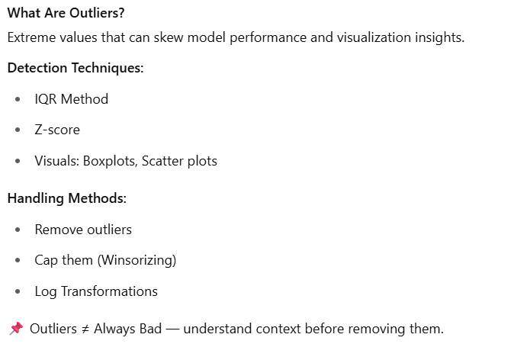
Outlier Detection & Handling
IQR :- Q3-Q1 (Inter Quartile Range)
Lower limit in boxplot :- min value
Easily detect garxa IQR le
Z-score:-
IqR is best for practice than Z-score
-2<2might be an outlier
-3<3 an outlier
Winsorizing capping eg – [2,4,6,8,10,11] close rakhna pareyo
Variance rakhna

Slide 5
Short break

Slide 6
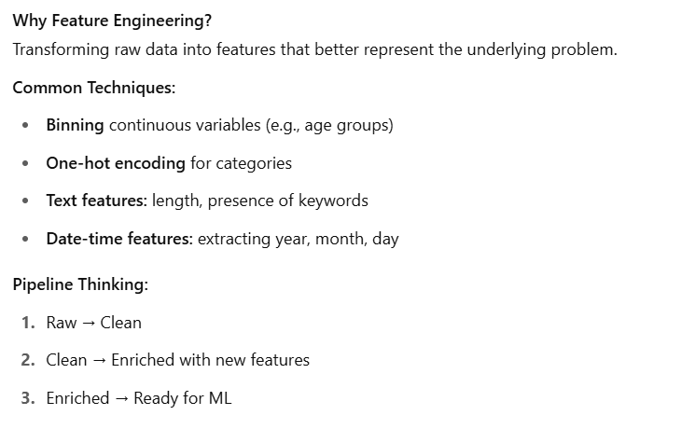
Feature Engineering Techniques
One-hot :- categorical lai int ma change

Slide 7
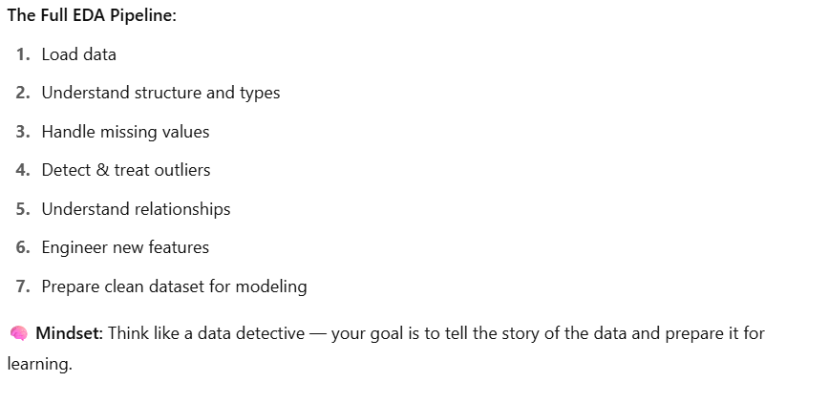
EDA Summary & Pipeline Wrap-up

Slide 8
Main Break

